Slide 1



Capstone project Phase A 24-2-D-8 Lior Jigalo Advisor: Shimon Faitelson

Slide 2

Part 1 Introduction

Slide 3





Inspiration
100,000 police reported crashes
1500 fatalities
71,000 injuries
40% of drivers admit they have fallen asleep while driving
The Zebra "drowsy-driving-statistics“ January 31, 2023
Notes:
The inspiration for this project speaks for itself.
100 thousand crashes
1500 deaths
71 thousand injuries reported
In a survey, about 40% of drivers admitted to falling asleep while driving: 10% of those drivers admitted to this behavior in the past year and 27% admitted they fell asleep in the past month.

Slide 4

Alertwatch project
The Alertwatch project aims to enhance road safety by monitoring the users face and detecting if the user falls asleep while driving as well as alerting the user.
Notes:
The Alertwatch project comes to make the roads safer, this project makes emphasis on road safety, monitoring the driver in real time and detecting decline in alertness. And alerting the driver if needed.

Slide 5

Part 2 Existing solutions
Notes:
Lets see some existing solutions

Slide 6


Existing solutions
Mobileye Lane sway detection
Smartwatches
Tesla Autopilot
Notes:
The existing solutions are mainly based on reactive measures like Mobileye lane sway detection, smart watches that monitor your biologic signs and can alert you using haptic feedback. These solutions are not sufficient as they are reacting to an already potential danger. Another type of solution is autonomously driving cars, however as you may expect these solutions are rather expensive and not applicable to the absolute majority of cars that are already on the roads.

Slide 7

Part 3 Planned Objectives
Notes:
So, what are the objectives of this project?

Slide 8
Proactive alertness management
Rather than reacting to the car being out of the lanes or about to hit something, we want to prevent that by proactively detecting signs of drowsiness in the earliest stage possible.
Notes:
As we know, the best defense is offence, A proactive solution should detect drops in alertness at the earliest stage possible, without allowing the users to even get themselves into dangerous situations

Slide 9
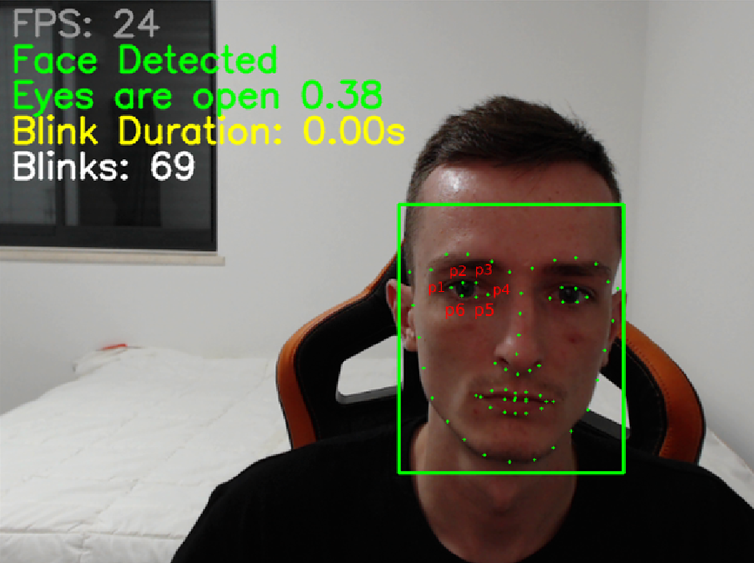
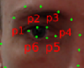

Real-time facial monitoring
The key feature of the system is monitoring, analyzing and assessing the alertness drop based on EAR (eye aspect ratio) values.
$$Eye aspect ratio = \frac{\left|\left|p_{2}−p_{6}\right|−\left|p_{3}−p_{5}\right|\right|}{2\left|p_{1}−p_{4}\right|}$$
Notes:
The key pillar of the Alertwatch project holds on is facial detection and monitoring, allowing to calculate the eye aspect ratio to analyze the alertness of the user.
In easy terms, this gives us the openness of the eye.
In addition, we can monitor when the user yawns as well as potentialy where the user is looking, all based on 68 facial landmarks, however that is a stretch goal and is not in the scope of the project.

Slide 10





Versatile deployment across environments
Automotive
Offices
Security
Military
Many Other
Notes:
While mainly focused at the automotive market, Alertwatch can be deployed at a wider range of usages requiring alertness assessment such as offices, security field, military & other critical areas.
You will be right to ask yourselves Why is different than other similar projects? Which leads us to the next slide.

Slide 11


Fanless & low power EDGE solution
Fanless Design
High performance per watt
Notes:
Utilizing fanless design allows integration in extreme environments such as automotive, industrial and military applications, more specifically, the hardware is capable of working in industrial ambient temperatures of -40 to 85 degrees This allows deployment of the machine somewhere without worrying about frequent maintenance.
In combination with low power hardware the system can operate efficiently with high performance per watt at a low cost

Slide 12



Runtime environment
Notes:
Custom linux build systems YOCTO and BuildRoot are projects that allow us to create custom linux images, however, these two differ in many things. The main difference being that YOCTO is based on a layered architecture while Buildroot utilizes single configuration files (defconfig) and uses make and kconfig for build orchestration and configuration
Alertwatch operates in custom Linux environments built on Yocto & BuildRoot for all its components providing high flexibility and allowing us to utilize the most out of the hardware while remaining lightweight and fast.
This project uses 2 different images based on each one of these build systems… why? Because software engineers love to flex…

Slide 13
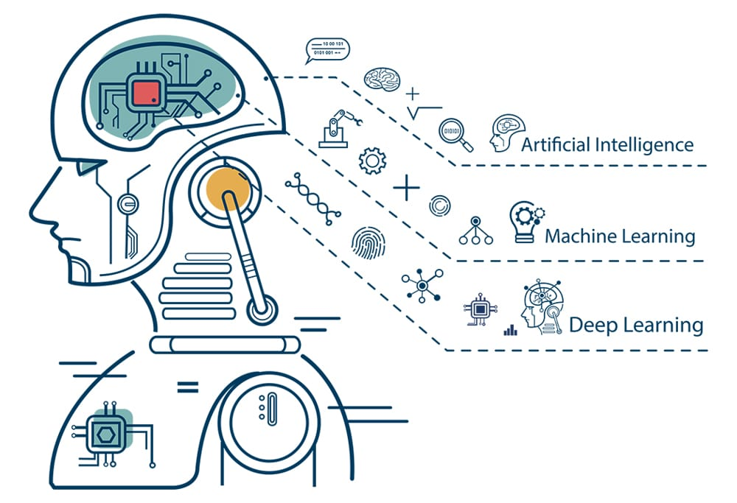

AI usage
PyTorch
SSD
ResNet18
Notes:
The artificial intelligence part of the project consists of 3 main parts, PyTorch, SSD and Resnet 18 PyTorch is used to train the face landmarks detection model based on Resnet18, as for SDD, a pre-trained model will be used due to its light and small architecture.
Anybody knows what SSD is? Wrong!
SSD is Single Shot MultiBox Detector
It is a deep learning algorithm used for object detection. It detects objects (like faces) in images by predicting bounding boxes and object classes in a single pass through the network making it very small and quick for better FPS.
Alternatively, a Yolov model can be used.
ResNet18 uses residual blocks, which include skip connections bypassing one or more layers. These connections enable the network to learn residual functions with reference to the layer inputs, effectively mitigating the vanishing gradient problem. Some might have heard about resnet 50 and restnet 101 which are very powerfull
So why use ResNet18 and not ResNet50? Lower computational complexity, faster inference, providing higher FPS which is crucial, although ResnNet50 would have probably given more accurate results, at the cost of lower FPS…

Slide 14
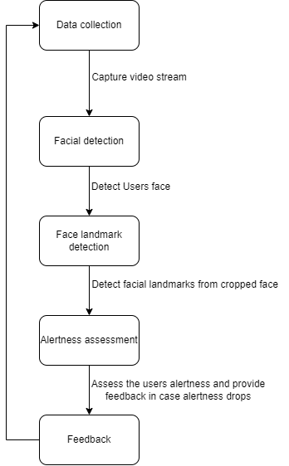
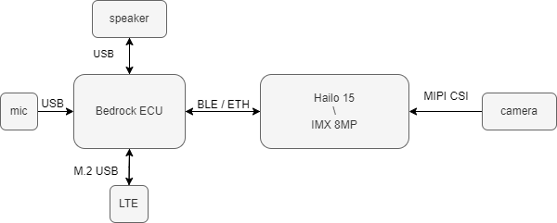
Data Flow & Architecture
Notes:
Data flow is shown in the diagram on the left. To make things straight, 2 AI models are used, first for facial detection, then the detected face is being cropped and preprocessed to a size of 224x224 grayscale and facial landmarks are being predicted on the cropped face.
The block diagrams on the right shows the hardware components used in the project. Utilizing a bedrock pc for ECU simulation which will have a microphone, speaker, an LTE modem and ethernet.
The Hailo15 board for the detection unit only has a MIPI-CSI camera and ethernet attached to it.

Slide 15
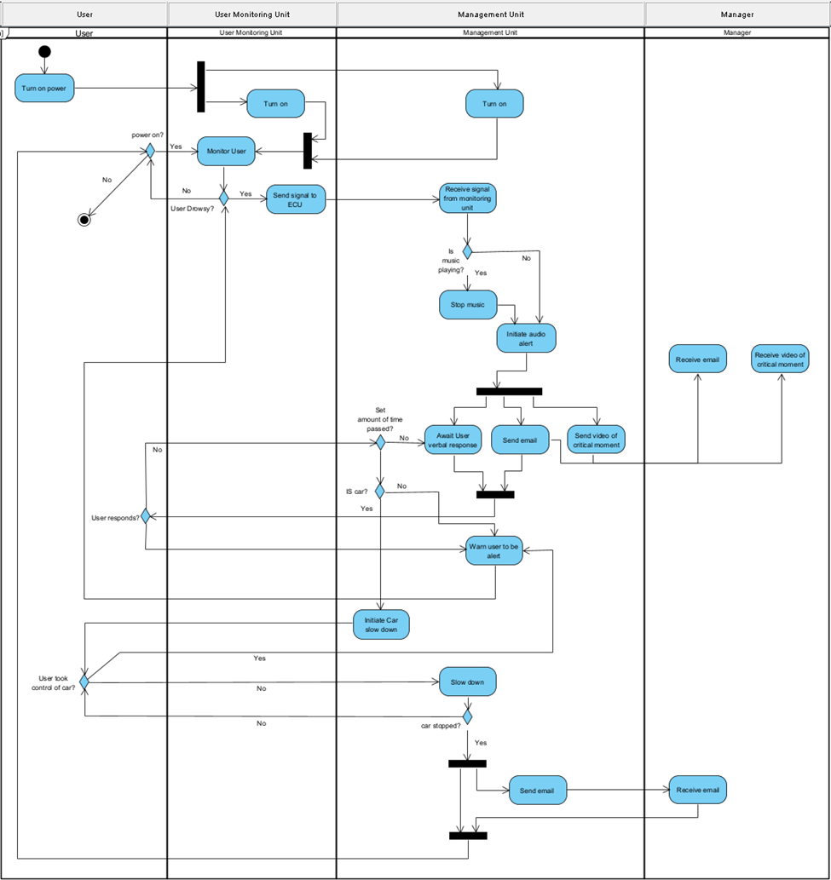
Notes:
Activity diagram: The user turns on the system, both the (Electronic Control Unit) and the detection unit are powered on. The monitoring unit looks for drops in alertness and if was detected it reports to the ECU, which will stop any multimedia playing at the time and expect a verbal response While potentially sending a report to a supervisor. If the user is alert and responded, the system issues a warning to be alert and resumes to its previous, monitoring state. If not, then the ECU will start gradually reducing the cars speed to prevent potential accidents.

Slide 16

Part 4 Hardware options
Notes:
Let’s go over the hardware selection, you have all the hardware in front of you to play around with.

Slide 17
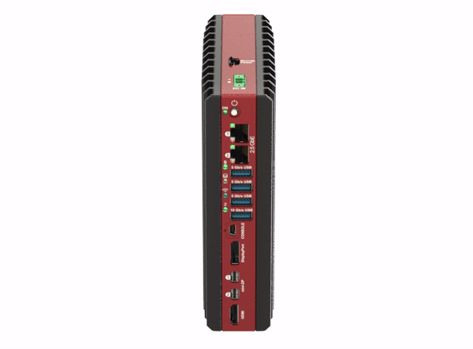


SolidRun Bedrock R7000
Feature | Spec
CPU | AMD Ryzen™ 7040 Series 8C\16T
Temperature range | Industrial -40ºC to 85ºC
Enclosure | All aluminum enclosure Patented fanless cooling
Great performance per watt
Highly configurable
More info
Notes:
The Bedrock R7000 is a powerful AMD based product and can easily pose as an ECU, its flexible power controls allows tuning the device for the specific needs of the project to provide good performance with as little power consumption as possible.
Its Industrial temperature range and patented passive cooling solution allow it to be deployed in various extreme environments.

Slide 18
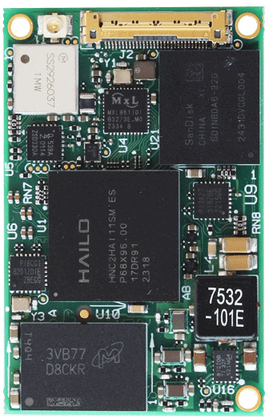

SolidRun Hailo 15H
Feature | Spec
CPU | 4 x Cortex A53 @ 1.3GHz
AI Acceleration | 20 TOPs on Hailo 15H SOM Hailo patented
Temperature range | Industrial -40ºC to 85ºC
Size | 47x30mm
More info
Notes:
The Hailo 15H CPU features a powerful integrated 20 TOPS NPU allowing to provide great AI Inference performance, while consuming very little power. The small form factor of the SOM allows development of a custom carrier board tailored specifically for this projects needs, However, unfortunately, this is not in the scope of the project.

Slide 19
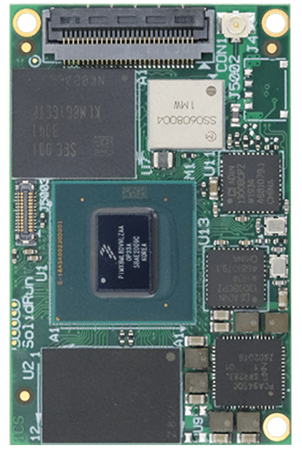
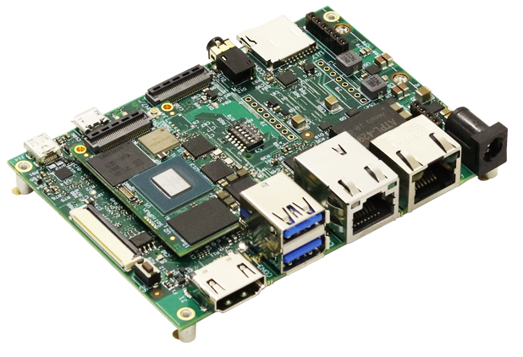

SolidRun i.MX 8MP
Feature | Spec
CPU | NXP i.MX 8M Plus 4x Arm® Cortex®-A53 @1.8 GHz
Temperature range | Industrial -40ºC to 85ºC
Size | 47x30mm
More info
Notes:
The third and last option, is a bit more flexible, allowing to use an IMX8M plus SOM, with Hailo PCI express acceleration cards, such as Hailo 8 or Hailo 10 (unreleased yet). Although its small form factor, its reliability on extension modules for inference do not allow for much flexibility for overall size of a custom carrier like the hailo15H solution.

Slide 20
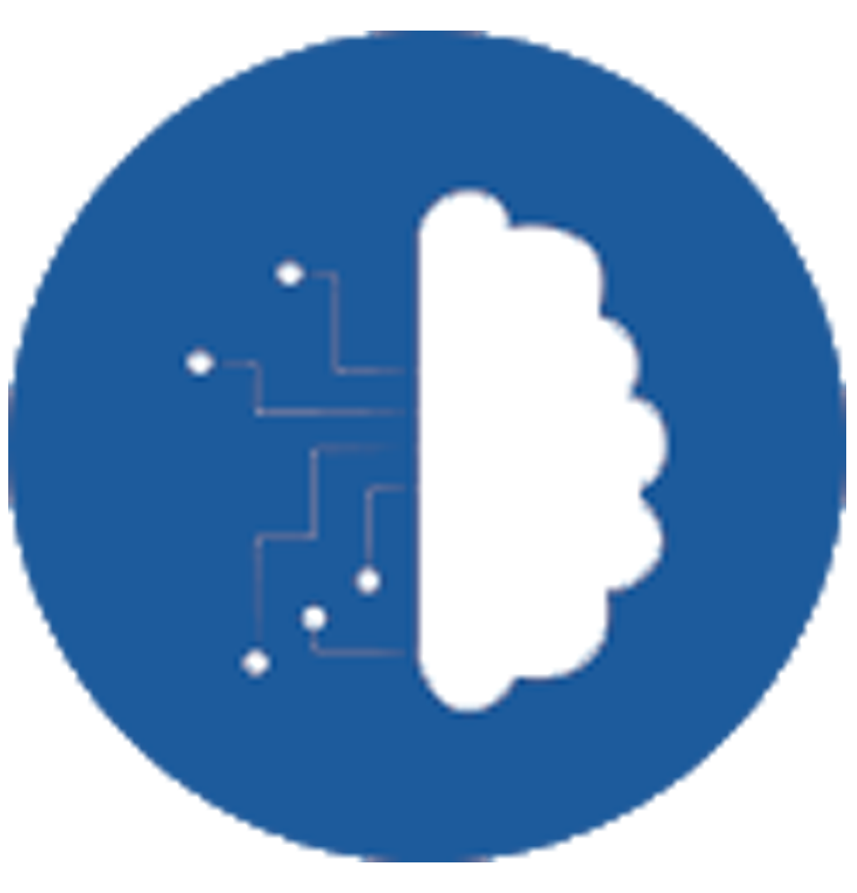
Part 5 Challenges & constraints
Notes:
As expected, moving complex AI computations and image processing to the edge poses some challenges

Slide 21
Software challenges
Hailo’s infrastructure lacks a wide community
Hailo’s tools are complex to understand
AI model training to a sufficient level requires resources
Notes:
Software constraits:
Hailo is a new company funded in 2019, their community forum was only launched about 6 months ago.
Naturally, their community is not established yet.
Usage of Hailo software is hard to understand as the process of translating a model to a format their hardware can use is very complex.
Also, resources are a problem, Training the current model took 7 full days to train to a good level with a GTX 1060 which makes continuous evaluation and improvement of the model very hard.

Slide 22
Hardware constraints
Low power consumption limits performance
The scope of the project does not allow development of a custom carrier board
Notes:
Hardware constraints
The hardware being low power limits the level of performance we can get
The project does not allow for development of a custom carrier board, therefore, the bigger evaluation board will be used, which has many unused components consuming more power for no reason.

Slide 23
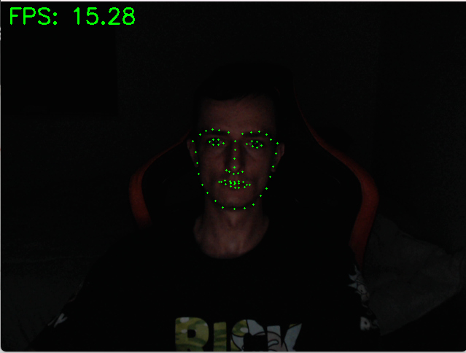
Physical Challenges
Sunglasses prevents detection
Lighting conditions
Notes:
An obvious limitation of the system is if the user is wearing sunglasses the camera will not be able to see the users eyes, however, if its light enough for you to need sunglasses chances are, you’re not falling asleep anytime soon.
Another limitation is lighting conditions, relying on a camera in dark environments can be challenging, however from tests I ran, the system can detect facial landmarks in pretty dark environments.
Also, the inference runs on 224x224 grayscale images, which allows integration of an infra red camera solving this issue altogether. However, this will not be implemented in the project.

Slide 24

Part 6 Testing Plan
Notes:
As all hardware and software, validation is mandatory, but for systems that will be used for safety that its integral

Slide 25
Hardware Validation
Category | Test | Expected result
Reliability | Oven testing in -40ºC to 85ºC | Stable system with no crashes
Stability | MemTester | Stable system with memory errors
Functionality | Overall interface testing | All interfaces are functional
AI usage | NPU self diagnosis | Firmware is able to communicate with NPU
Notes:
In hardware responsible for safety, stability is crucial, both in terms of hardware and software. The hardware will be tested in an oven between -40 degrees to 85 degrees Celsius, and should not have any memory errors or crashes while running memtester.
Also, Hailos firmware allows self diagnosis which grants us the ability to assess the state of the hardware while using the system.

Slide 26
Software Validation
Category | Test | Expected result
Connectivity | Communication between system components | All system components receive and transmit data with no packet loss
Detection | Face detection | The user’s face is detected
Detection | Face landmarks detection | Face landmarks are detected from the cropped face image
Accuracy | Face landmarks Placement | Face landmarks accurately placed on the cropped face image
Functionality | Alertness drop detection | Accurate detection of alertness drop of more than 20%
Notes:
Mainly relying on detection for this project, the emphasis on correct data transfer, and accurate face detection and landmark placement is crucial for the systems reliability.

Slide 27
Thank you! Questions?

Slide 28
Additional information

Slide 29

SolidRun Bedrock R7000
Feature | Spec
CPU | AMD Ryzen™ 7040 Series 8C\16T
GPU | AMD Radeon™ 780M
AI Acceleration | Up to 3x Hailo-8 M.2 AI Inferencing Acceleration Module 26 TOPS Up to 2x Hailo-10 M.2 Generative AI Acceleration Module 40 TOPS
Temperature range | Industrial -40ºC to 85ºC
Enclosure | All aluminum enclosure, fanless cooling
Main voltage | 12V - 68V
Continue presentation

Slide 30
SolidRun Hailo 15H
Feature | Spec
CPU | 4 x Cortex A53 @ 1.3GHz
GPU | N/A
AI Acceleration | 20 TOPs on Hailo 15H SOM Hailo patented structure defined dataflow architecture
Temperature range | Industrial -40ºC to 85ºC
Enclosure | N/A
Main voltage | 5V
Size | 47x30mm
Continue presentation

Slide 31
SolidRun i.MX 8MP
Feature | Spec
CPU | NXP i.MX 8M Plus 4x Arm® Cortex®-A53 @1.8 GHz
GPU | Vivante GC7000UL
AI Acceleration | Up to 3x Hailo-8 M.2 AI Inferencing Acceleration Module 26 TOPS Up to 2x Hailo-10 M.2 Generative AI Acceleration Module 40 TOPS
Temperature range | Industrial -40ºC to 85ºC
Enclosure | N/A
Main voltage | 5V
Size | 47x30mm
Continue presentation

